Slide 1
GIT

Slide 2
Sessions
Basics
Setup in Paypal
Steps to work in Paypal
The Extra Commands
Clearcase and GIT Comparison

Slide 3
Session1 – GIT Basic
Its Basically a source code control like CVS, SVN, Clearcase
Open Source
Lightweight Branching and Merging

Slide 4
GitConcepts
SHA1
The information needed to represent the history of a project is stored in files, each referenced by a unique 40-digit “object name” – a SHA1
Blob
Object that stores the content of a file
Tree
Object that represents the contents of a directory; contains a set of pointers to blobs and other trees
Commit
Object that has a link to the repo’s top-level tree (version of the source tree), commit message (a description of how we got there and why) and any parent commits

Slide 5
Git Concepts …
Tag
Tag object assigns an arbitrary yet presumably human-readable name to a specific object, usually a commit
The .git directory
Each git repository has a hidden directory “.git” which holds the repo’s vital database of information

Slide 6
GitConcepts …
Shared Repository
A Git shared repository resides on a server and is used for cloning, pushing and pulling
Clone
A repository for development, it is a full copy of a repository and includes a working tree that allows you to modify, add, delete files

Slide 7
GitConcepts …
The Index
A staging area between your working directory and your repo’s object database; tracks what you want to commit. When you run a “git commit”, gitcommits what is in the index (rather than what is in the working directory)
File Classifications in Git
Tracked
A tracked file is any file already known to Git (already committed or
staged in the index). To add a new file to the index, run “git
add <file_name>”
Ignored
An ignored file must be explicitly declared “invisible” or
“ignored” in the “.gitignore” file in the repository
Untracked
An untracked file not found in previous two categories. Use “git
add” to track files in Git

Slide 8
Repository Model for PayPal:
There will be three kinds of repositories.
Data Repository (.repo)
This repository will contain actual data. It will have limited access and will be backed up regularly.
Similar to VOB in CC.
Bare Repository (.bare)
This repository does not have code and is only used for cloning, push and pull.
Clone Repository
This repository is clone from the bare repository and contains all files available in data repository.
Similar to snapshot view in CC.

Slide 9
Session 2 - Steps for GIT Setup - WebDev
Migrate the project to GIT from Clearcase/Create a stream
Hypers to be used.
Changing the SHELL to bash
.bashrc.webdev changes (optional)
Key Generation, to make your user-id passwordless
Code Review Registration

Slide 10
Step 1 – Migration From GIT to Clearcase
Use the links given below, for (non-live code projects) and fill out the form.
http://devprod.paypal.com/initiatives/projects-in-progress/git-docs/Git_Project_Request.docx/view
After filling it, Email the form to
DL-PP-GiTMigration-Team.

Slide 11
Step 2 – Hypers to be used
PPSB Hypers: hyper65.ca1.paypal.com to hyper100.ca1.paypal.com
Non-PPSB Hypers: hyper40.ca1.paypal.com to hyper64.ca1.paypal.com
To enter into the hypers, type
“ssh <userid>@hyper103.ca1.paypal.com”

Slide 12
Step 3 – Changing the SHELL to Bash
If SHELL is “csh” or “tcsh”, change the shell to bash
“chsh user /bin/bash”, is the command taken from internet
Normally type “bash” in the command line
To know about which SHELL, “echo $SHELL”

Slide 13
Step 4 - .bashrc.webdev changes
.bashrc.webdev is a file, where we need to set the GITHOME and PATH environment variables for running the GIT Commands. Normally it resides in “/x/home/<username>”, if it doesn’t exist create a new one
Production Git Environment
export PATH=$PATH:/git_global/gitsys/bin
export GITHOME=/snaps#/<user_id>/githome
Lab Git Environment
export PATH=$PATH:/git_lab_global/gitsys/bin
export GITHOME=/snaps#/<user_id>/githome
Or add
export GITHOME=/snaps#/<userid>/githome
export PATH=$PATH:/git_global/gitsys/bin/p4v-2010.1.265509/bin:/git_global/gitsys/bin:/git_lab_global/gitsys/bin/p4v-2010.1.265509/bin:/git_lab_global/gitsys/bin
After Inserting the commands, source the file
“source /x/home/<username>/.bashrc.webdev”

Slide 14
Step 5 – Key Generation
Run "ssh-keygen -t rsa“
Do not enter a passphrase when asked for, just hit enter
Cat the id_rsa.pub file and copy the generated keys
Paste the copied ssh keys to /x/home/<userid>/.ssh/authorized_keys
Make sure that /x/home/<userid>/.ssh/authorized_keys has permission set to 600.
“chmod 600 /x/home/<userid>/.ssh/authorized_keys”

Slide 15
Step 6 - Code Review Registration
Log into http://hyper106.ca1.paypal.com:2080/ with your corp username and password.
click on the “Settings” link on the top right hand corner
click on “Contact Information” in the setting page. Enter your full name in the space provided and click “Register New Email” button and give user id and click register. [Note: Pls give your email id in this format only, rabalasubramania@corp.ebay.com, corp.ebay.com is must, then only you will get mail]
you will get an email containing a link, from Gerrit to your official mail id. Copy that entire link and paste that in the url bar of your browser (current gerrit page). This step confirms your email id.

Slide 16
Once this done, again go to “contact information” and verify your full name and email id and click “save changes” button.
Add SSH Key in the following way,
  Log into a client machine (hyper 60 -100)
  Cd into /x/home/username/ and run “ssh-keygen –t rsa” and keep pressing enter key without giving any inputs. [if it prompts for you to overwrite existing ssh keys give yes]
  Now your public key for this machine will be stored in this path - /x/home/username/.ssh/id_rsa.pub. Copy the contents of this file
  In the gerrit webpage under “settings ->SSH Public Keys” and paste the contents of the above ssh key file, click “Add Key”.

Slide 17
Session 3 – Steps to work in Paypal
Make sure you have exported the path for GIT.
Join Stream.
Create symbolic link till your “all” folder of your stream.
Note: There is no check-in or check-out in Git.
Open the file and modify/Create new file.
Add the file to index when ever changes are made to make sure you don’t lose it(This does not mean your changes are added to main stream) [Whatever files are added to index will be committed when we give commit.]

Slide 18
aml2pageXsl.pl will work in Git in the same way as it works in CC.
Commit the changes [most important – any mistake in this process will have more process to revert back the wrong changes] (Validation is done automatically)
Code Review.
Push the changes.
Pull the changes [If there are any new changes done by others in same stream].

Slide 19
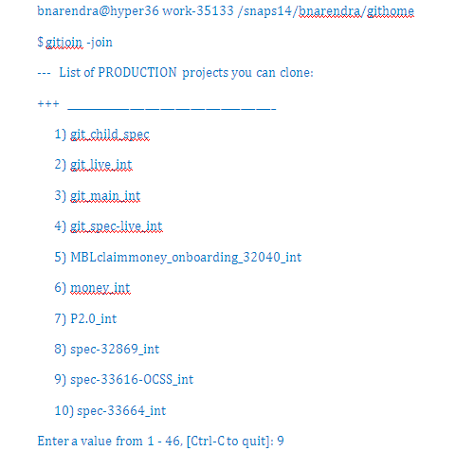
1) GIT Join
Command :
gitjoin -join [-release release] (or) simple “gitjoin -join”
Eg : gitjoin -join -release spec-35133_int
First, it will ask for the spec number, search the spec number and type the currect number

Slide 20
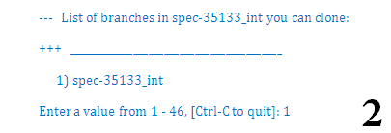
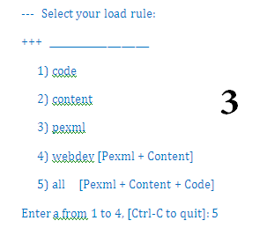
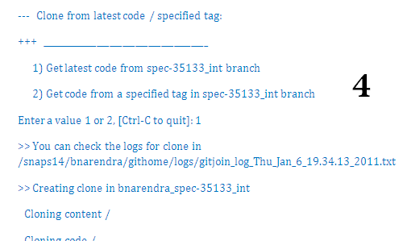
Second, It will ask for branch number
Third, It will ask for the load rule number
Fourth, it will ask for the clone type

Slide 21
2) Symbolic Link Creation
“ln –s /snaps**/<uid>/githome/<User_StreamName>/all”
Note: We can directly work on the files without any check-in.
Always create symbolic link like,
/snaps12/bnarendra/githome/ bnarendra_spec-35133_int/all
And not to /snaps12/bnarendra/githome/ bnarendra_spec-35133_int/pexml
Reason: some scripts will not work when symbolic link is created for pexml.

Slide 22
3) Modify/Create a File
To Create a file, touch command is used
$ touch <filename>.aml
To Modify a file, git add command is used
$ git add <filename>.aml
To modify already existing file, we need to use only “git add” command
To create a new file, we need to use both “touch” and “git add” command.

Slide 23
4) Debug a file
To debug a file, we need to use aml2pageXsl.pl, the same procedure what we do in the clearcase
“aml2pageXsl.pl <filename.aml> loggedInResultDoc.xml”
Validation is automatically done, when we do aml2pageXsl
If you want to do validation explicitely, then the below command is used
“gs –validate <filename(optional)>” or simple “gs -validate”

Slide 24
5) Commit the Changes
Make sure before commit, “git add” command is run to track the changes
To commit the file for a feature is
“git commit –m <<Feature FeatureID comments>>”
To commit the file for a bug is
“git commit –m <<Bug BugNumber comments>>”

